Slide 1


Software Quality Engineering (Week-6)
Usama Musharaf
LECTURER (Department of Computer Science)
FAST-NUCES Peshawar

Slide 2
Content of Week # 6
Quality Attributes:
Reliability

Slide 3
Reliability

Slide 4
Reliability
Software reliability is defined as the probability of failure-free operation of a software system for a specified time in a specified environment.

Slide 5
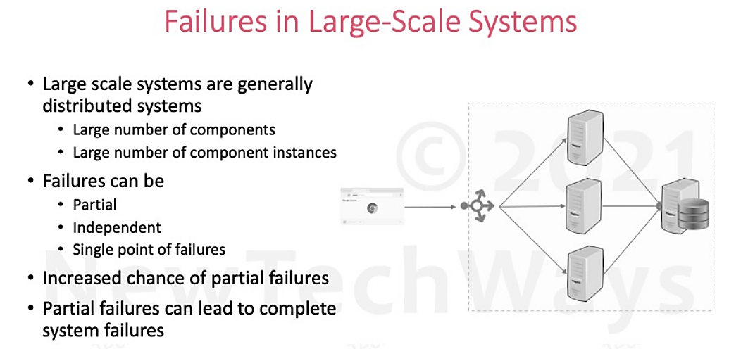

Slide 6
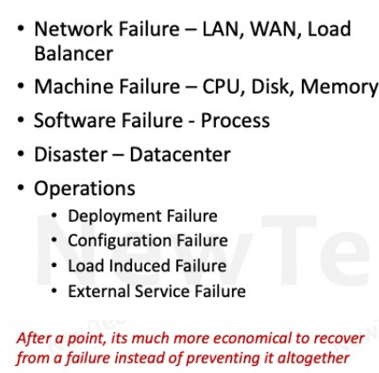
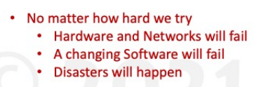
Partial Failures

Slide 7
Reliability Engineering
Reliability
Availability
Fault Tolerance

Slide 8
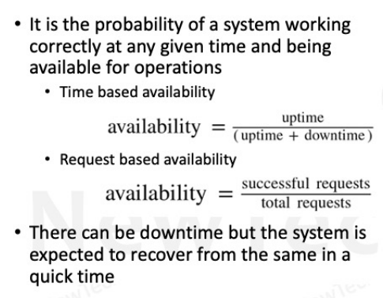
Availability

Slide 9
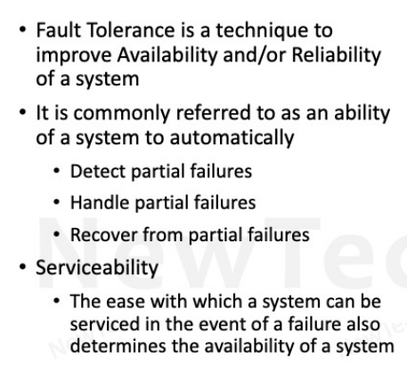
Fault Tolerance

Slide 10
Fault Tolerant Design
Redundancy
Fault Detection
Recovery

Slide 11
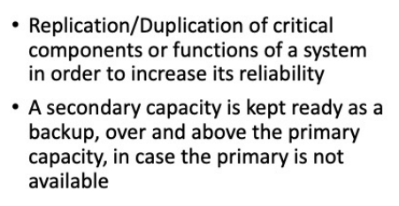
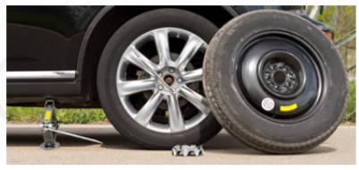
Redundancy

Slide 12
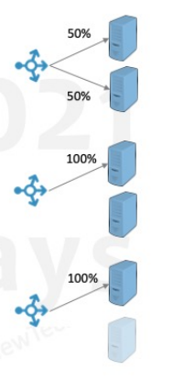

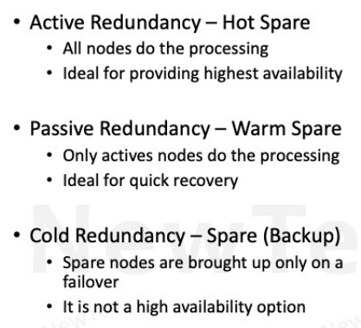
Types of Redundancy

Slide 13
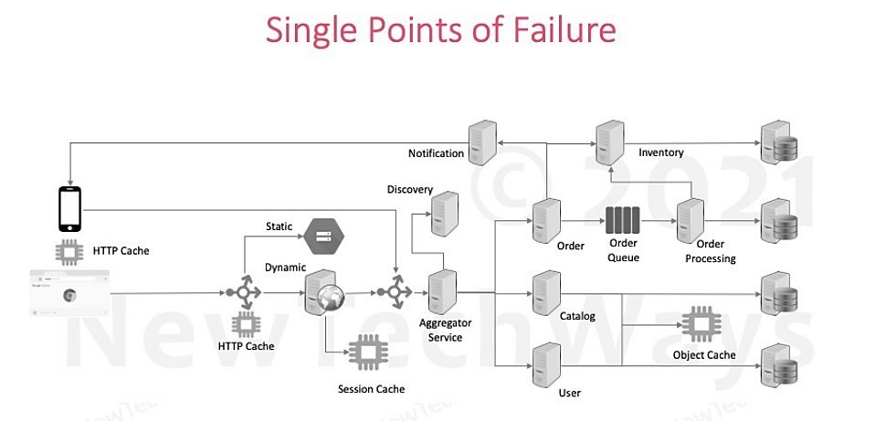

Slide 14
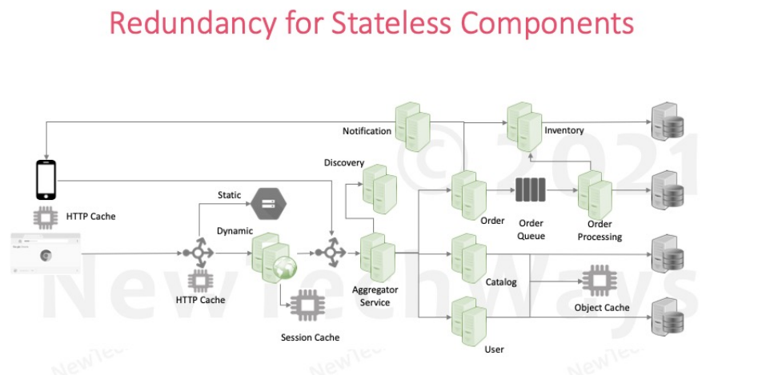

Slide 15
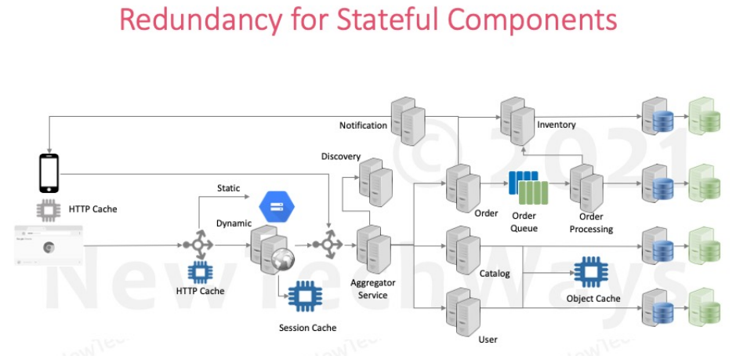

Slide 16
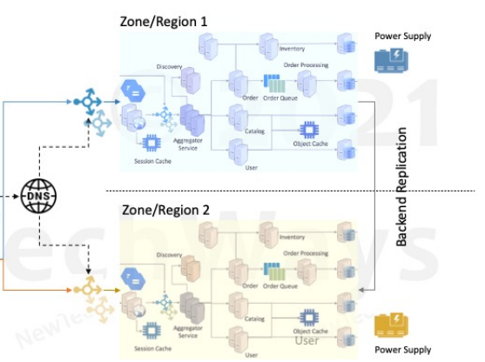
Datacenter Redundancy

Slide 17
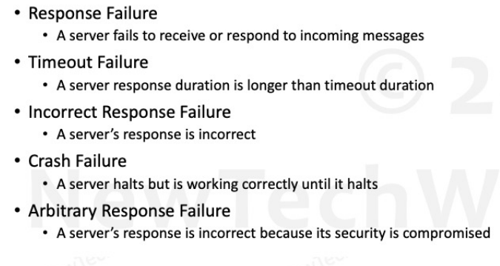
Fault Models

Slide 18
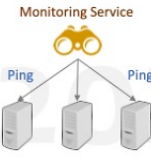
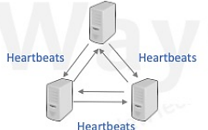
Health Checks
External Monitoring Service
Ping based
Internal Cluster Monitoring
Heartbeat based

Slide 19
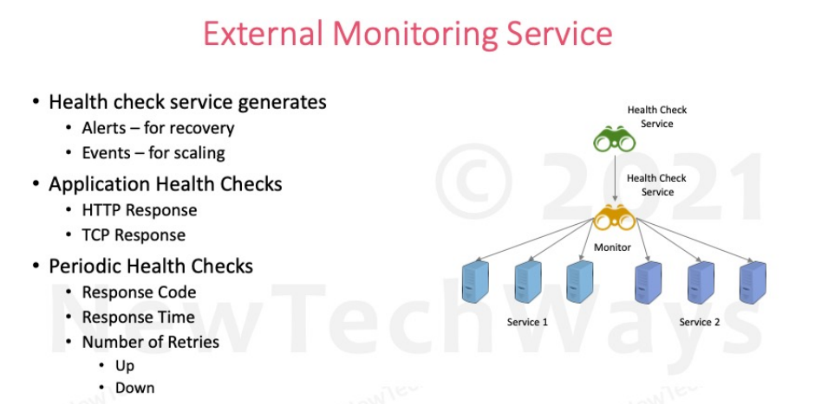

Slide 20
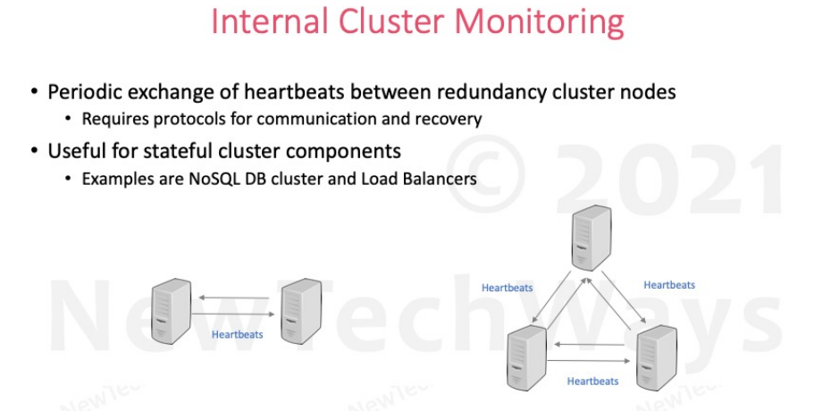

Slide 21
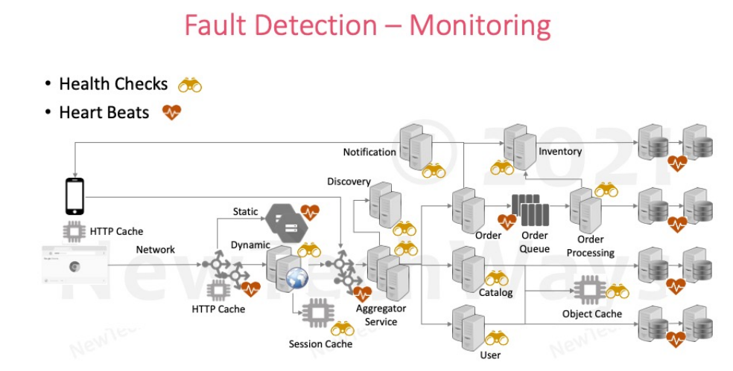

Slide 22
HAVE A GOOD DAY !

